Slide 1
Research and Documentation group Omdena-Australia JoyBot: A chatbot to boost the mental health of Australians

Slide 2
Introduction
The aim of this research project is to design a chatbot for boosting mental health of Australians.
The research objectives (ROs) in this section, on the other hand, are
To identify and discuss how mental health can be assisted with chatbot projects in Australia (RO1);
Examine the level of health challenges in Australia (RO2);
speak with mental health professionals; and learn critical measures to preserving overall well-being(RO3);
Create a prototype chatbot or web tool to assist people in sticking to a healthy routine(RO4);
Test the prototype to see how it affects the user's experience(RO5).

Slide 3
Background and current practices
COVID-19's potential to affect mental health and wellness was recognized early on in the pandemic (WHO 2020)
Many Australians' mental health has been harmed by the unexpected loss of job and social connection, the added stressors of moving to remote work or schooling, and, more recently, the effects of sudden, localised 'lockdowns' to prevent further breakouts. As a result of the pandemic, stress, bewilderment, and anger are widespread (Brooks et al. 2020), and while many people may not have long-term mental health issues, COVID-19 has the potential to contribute to or aggravate long-term mental disease(Fegert et al., 2020).
Many researchers acquired evidence of increased psychological suffering during the epidemic during 2020 and the first months of 2021. (Aknin et al. 2021).
While there was an increase in the use of mental health services and psychological distress in 2020 around the world(Xiong et al., 2020), COVID-19 was linked to an increase in suspected suicide deaths from mental breakdown in Australia(Leske et al., 2021).

Slide 4
Background and current practices
The use of mental health services continued throughout 2021 in other part of the world(Gruber et al., 2021) while a range of mental health-related services provided by various levels of government are available to support Australians with mental health concerns, as mentioned in other parts of Mental Health Services in Australia (MHSA)(Indicators-collapse, n.d.).
During the COVID-19 pandemic, the AIHW has been aiding the Australian Government Department of Health in curating, analyzing, and reporting on mental health-related service activities since April 2020. Data from the Medicare Benefits Schedule (MBS), Pharmaceutical Benefits Scheme (PBS), crisis and support organizations (Lifeline, Kids Helpline, Beyond Blue), and analysis of upcoming research findings are presented in two dashboards namely a national version and a jurisdictional version that focuses on service activities in New South Wales, (Abd-Alrazaq et al., 2019)Victoria, and Queensland. (Shelly et al., 2021).
In addition, the AIHW has assisted the governments of New South Wales, Victoria, and Queensland in providing detailed statistics on the usage of mental health services.

Slide 5
Background cont’d
Lifeline had many historical record-breaking daily call volumes, with 96,273 calls offered in total, up 14.1 percent and 33.1 percent in 2020 & 2019 resp
While rich countries have approximately 9 psychiatrists per 100,000 people, low-income countries have as few as 0.1 psychiatrists per 1,000,000 people .
Mental health services do not reach around 55 percent and 85 percent of people in industrialized and developing countries, respectively, according to the World Health Organization .
Suicidal behavior may come from a shortage of mental health services, resulting in increased mortality [10]. Due to a shortage of mental health workers, technological innovation has been used to satisfy the requirements of people who are impacted by mental health issues .

Slide 6
Related works
Chatbot & Its Features
Chatbots are artificial intelligence algorithms that converse with users in natural language(Shawar & Atwell, 2007).
Goal is to trick consumers into thinking they were talking to actual people.
Chatbots can be implemented into a variety of platforms, such as mobile apps, websites, SMS texting, smart technology, and virtual reality
It can be text-based or video-based or both
It can be used for diagnosis,triaging person with mental issues,deliver psychotherapeutic therapies , commitment therapy and counselling

Slide 7
Chatbot for Mental health
iHelpR
WySA
WoeBot
ViviBot
Mylo etc

Slide 8
Methods used in this project
Text Mining – twitter scraping
Cleaning data with Regex libraries
Exploratory Data Analysis
Topic Modelling with Latent Dirichlet Allocation(LDA)
N gram of words
Design of Chatbot with RASA
GUI with forms
Deployment of the app with Streamlit

Slide 9
Datasets
Official Data
COVIDiStress
Chatbot data
-Counsel Chat
Social Media
Forums - FAQ

Slide 10
Datasets
228,874 tweets was scraped on January 22nd 2022, from twitter with 24 columns applying tweepy python method using the following keywords:
abuse, addiction, angst, bipolar, circuit breaker, community cases, coronavirus, counselling, counsellor, covid, crisis, dead, death, dependence, depression, disorder, drugs, dysthymia, emotion, fatality rate, fight, hbl, heightened alert, help, home based learning, imh, insomnia, irritable, isolation, jobseeker, job keeper, jobmaker, job, insecurity, lockdown, loneliness, lonely, melancholia, mental health, mental illness, mood disorder, mood swings, national emergency, neurosis, no motivation, outbreak, overwhelmed, paranoia, phobia, post-traumatic stress, disorder, pre-covid, psychologist, quarantine, redundancy, restriction retrenchment, rona school closure, self-esteem self-harm shn social anxiety, socialize, sos, stay home notice, stood down, stigma, stress, suicide, therapy, tighter measures, tired, toxic, trapped, trauma, unalive, uncertainty, variant, well-being, wfh, work from home.
The corpus was pre-processed and cleaned using NLTK methods.

Slide 11
Datasets contd’
The attributes of the dataset was
url, date, content, rendered 'Number', 'Unnamed: 0', 'id', 'user', 'replyCount', 'retweetCount', 'likeCount', 'quoteCount', 'conversationId', 'lang', 'source', 'sourceUrl', 'sourceLabel', 'inReplyToTweetId', 'inReplyToUser', 'mentionedUsers', 'coordinates', 'place', 'hashtags', 'cashtags', 'char_cnt', 'word_cnt', 'sentence_cnt', 'avg_word_size', 'avg_char_per_sent', 'avg_word_per_sent', 'stop_cnt', 'avg_stop_per_sent', 'avg_stop_per_word’
Other inferences deducted from the data are Number of Characters, Number of words, Number of sentences per tweets, average word size, average character per tweet, average word per sent, stopword and stop word percent using NLTK. Using average perception tagger and punkt library, others were deducted like the Noun count, Pronoun count, proper noun count, modal, verb present, verb past, adjectives count and word token count.

Slide 12
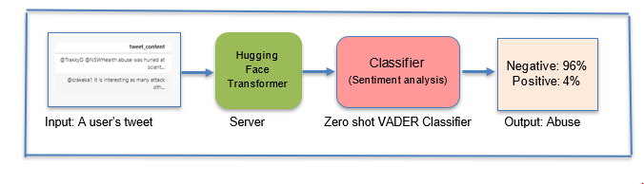
Process Frameworks
We designed 2 Frameworks (still have chatbots design)
Process Framework
Classifier Framework

Slide 13
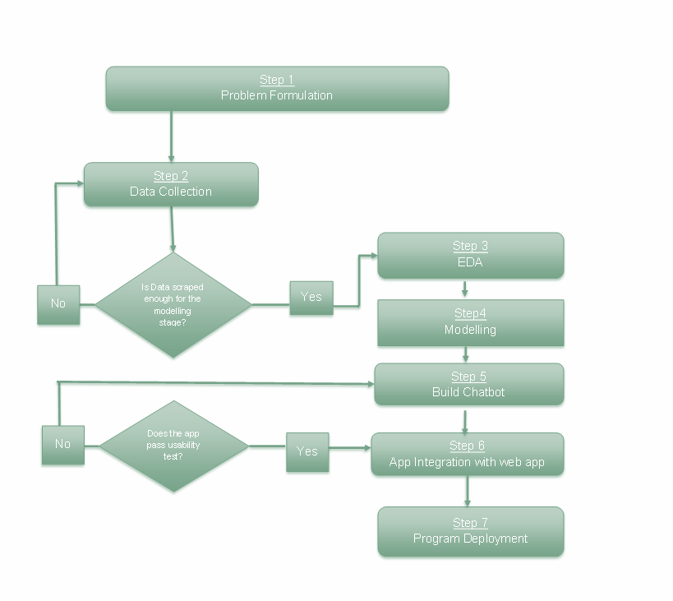

Slide 14
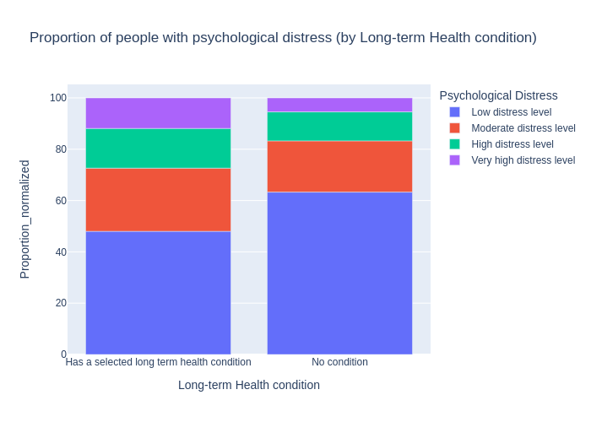
Results – EDA
Figure 3: Proportion of Australians with Psychological distress by long-term health condition
This shows that High proportion of people with long term health condition has high distress level compared to the people with no condition

Slide 15
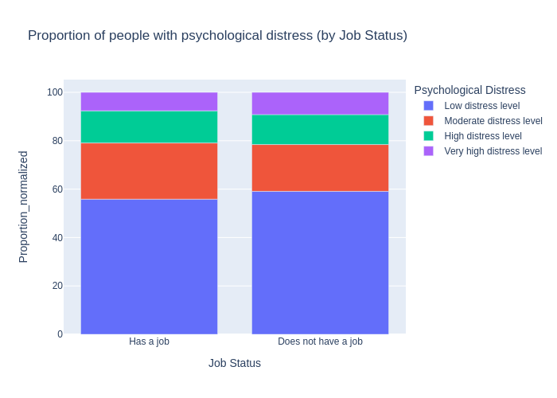
EDA results contd’
Figure 4: Proportions of Australians with Psychological distress by Job Status
This shows that the Australians with a Job have a slight lower distress level than the one without Jobs

Slide 16

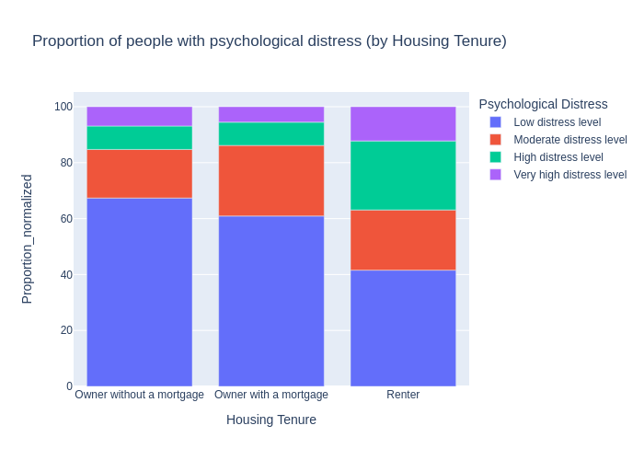
EDA results contd’
Figure 5: Proportions of Australians with Psychological distress by Housing Tenure
This figure shows that Australians with rented apartment have higher distress level than with house owners with or without morgages

Slide 17
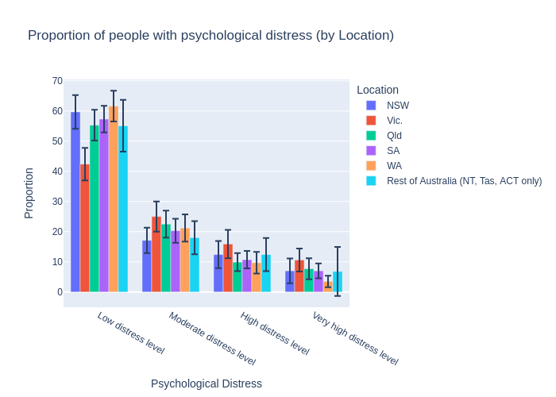
EDA results contd’
Figure 6: Proportion of Distressed Australians by Location
This shows that People in Victoria are very distressed than New South Wales ,Queensland,South Australia,West Australia and the rest of Australia

Slide 18
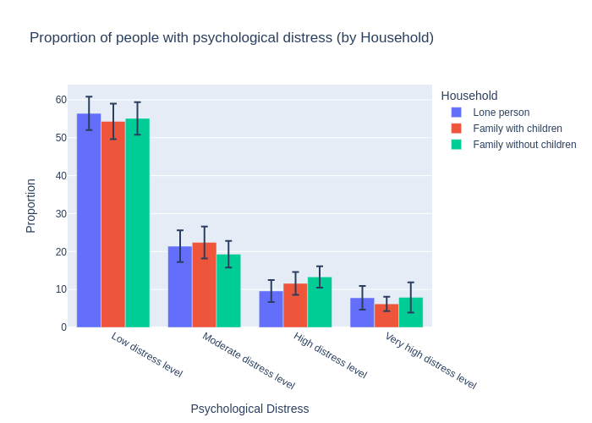
EDA results contd’
Figure 7: Proportion of Psychologically distressed Australians by Household type
This shows that Lone Australians and without children are equally distressed than the one with Children.

Slide 19
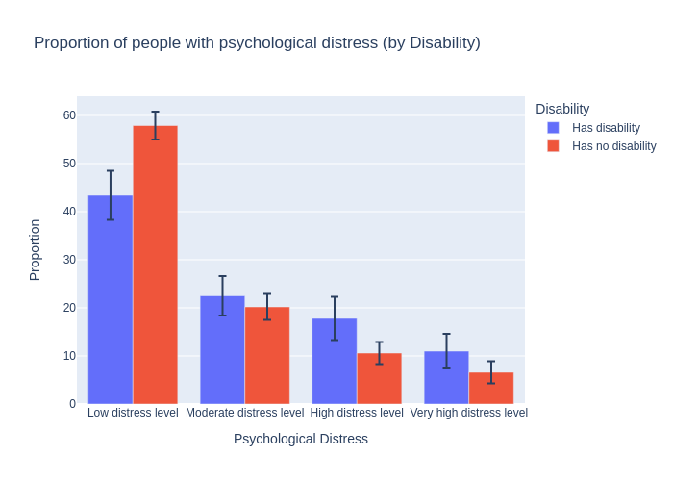
EDA results contd’
Figure 8: Proportion of Distressed Australians by Disability
This figure showed that disabled Australians are highly distressed than the one without disability

Slide 20
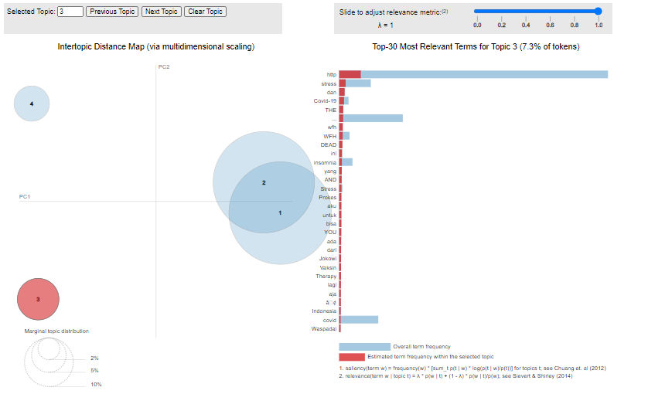
Results – Topic Modeling with LDA
Figure 9: LDA showing 30 most used Topics in the tweets scraped

Slide 21
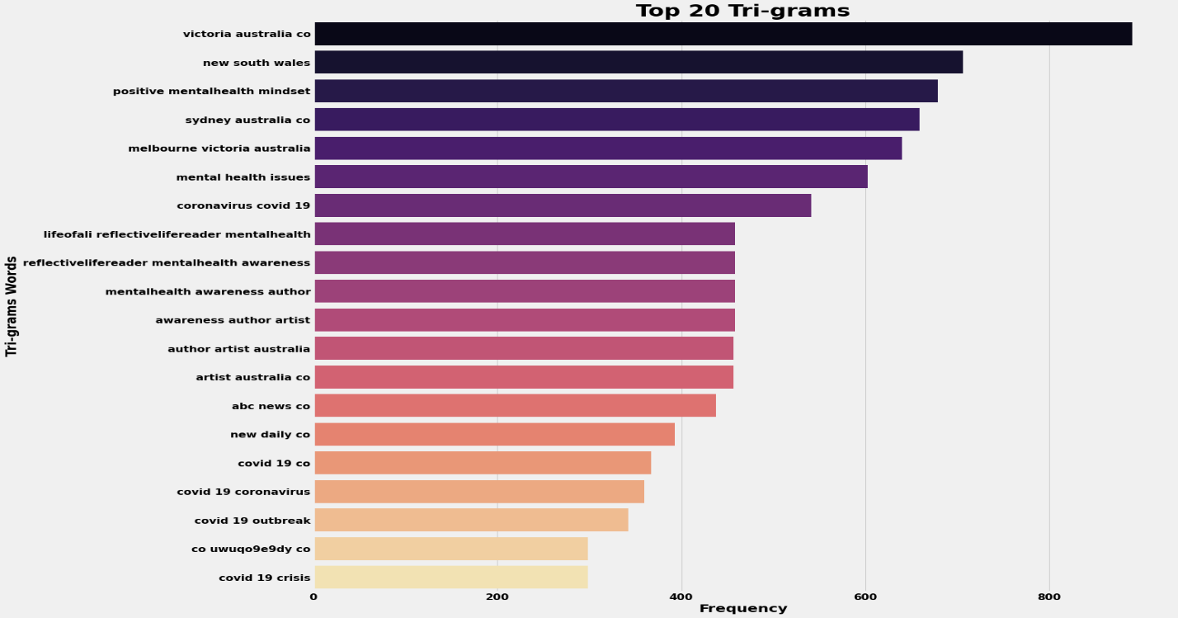
Results - Trigrams
Figure 9: Top 20 Trigrams

Slide 22
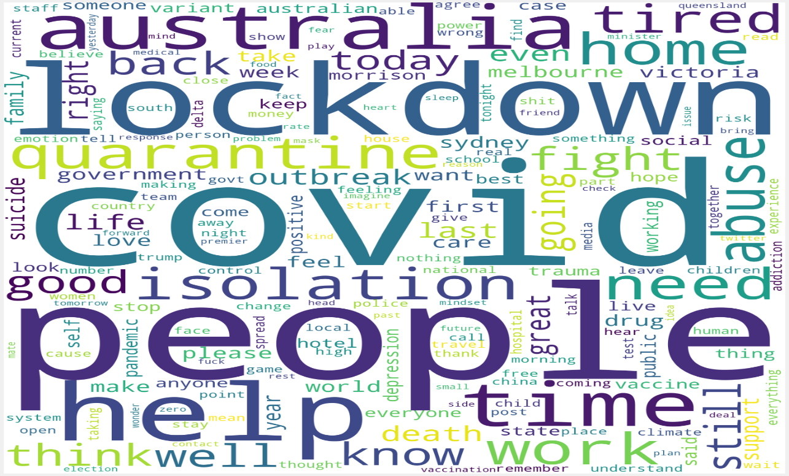
Results- Wordcloud
Figure 10: Stopclouds showing the most frequently word used during this time
This shows that Covid, people, lockdown, tired, home, help and health, etc, even when different contextual keywords were used to scrape the twitter, ensuring that mental health is one of the buzzing topics during the pandemic.

Slide 23
Results - Chatbots

Slide 24
Results – Chatbot Evaluation

Slide 25
Conclusion
This shows that Australians are psychologically distressed based on the following Factors: Long term health issues, Job Status, Housing, Location, Family type and Disability thereby giving us a lead to train our data based on these pointers.
Chatbots passed the test with------
And finally the We were able to achieve the Research objectives
To identify and discuss how mental health can be assisted with chatbot projects in Australia (RO1) – This we did by the first meeting and the background study of the project
Examine the level of health challenges in Australia (RO2); - The EDA shows long term health condition can affect a high psychological distress among Australians

Slide 26
Conclusion contd’
Speak with mental health professionals; and learn critical measures to preserving overall well-being(RO3); - Interview with Beth was an eye opener to how mental health can be discovered and managed
Create a prototype chatbot or web tool to assist people in sticking to a healthy routine(RO4); - About to finish JoyBot using RASA framework with form GUI
Test the prototype to see how it affects the user's experience(RO5).

Slide 27
Acknowledgment
Special thanks to OMDENA- Australia specifically Tanya Dixit for the initiative of this project
Special thanks also goes to our Chapter lead, Mr Adish Ashraff for bringing us together on this project and leading us with patience and understanding
Thanks also Tanya Dixit for the wonderful guide and pointer on the requirements for this project
I would also like to thank my fellow Task leads Nica, Nilkhil, Bhushan, Anne, Navaneeth, Sai
I would also like to thank my Team members for your unflinching support and help with this work like Bhushan, Sudha, Ambika and the rest
Finally to all the Collaborators, thank you for your support

Slide 28
References
Abd-Alrazaq, A. A., Alajlani, M., Alalwan, A. A., Bewick, B. M., Gardner, P., & Househ, M. (2019). An overview of the features of chatbots in mental health: A scoping review. International Journal of Medical Informatics, 132, 103978.
Gruber, J., Prinstein, M. J., Clark, L. A., Rottenberg, J., Abramowitz, J. S., Albano, A. M., Aldao, A., Borelli, J. L., Chung, T., & Davila, J. (2021). Mental health and clinical psychological science in the time of COVID-19: Challenges, opportunities, and a call to action. American Psychologist, 76(3), 409.
Leske, S., Kõlves, K., Crompton, D., Arensman, E., & De Leo, D. (2021). Real-time suicide mortality data from police reports in Queensland, Australia, during the COVID-19 pandemic: an interrupted time-series analysis. The Lancet Psychiatry, 8(1), 58–63.
Shelly, S., Lodge, E., Heyman, C., Summers, F., Young, A., Brew, J., & James, M. (2021). Mental health services data dashboards for reporting to Australian governments during COVID-19. International Journal of Environmental Research and Public Health, 18(19), 10514.

Slide 29
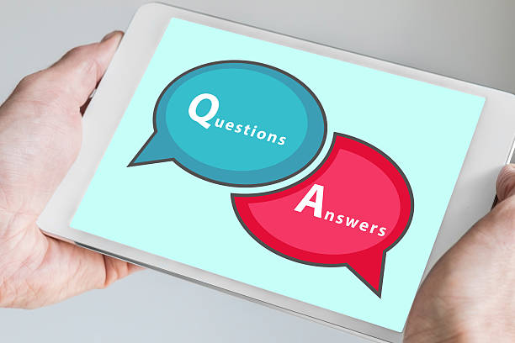
Conclusion

